Slide 1
Big Data Infrastructure
Group Members: P. Dyantyi, R. Bulannga, O. Mabuse, O. Magubeni, O. Menwe, M. Modiba
Shibu

Slide 2

Content
Introduction
Tools Used
Implementation
Demonstration
Future Work & Conclusion
Shibu

Slide 3
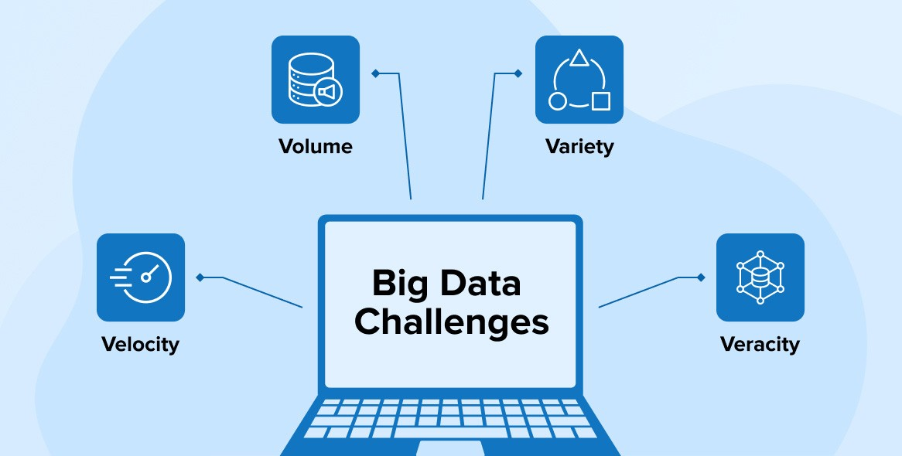
INTRODUCTION
Background of building Big Data Infrastructure
Problem Statement: Modern organizations face challenges in processing and analyzing large amounts of real-time and batch data from diverse sources like social media, IoT devices, and APIs.
Objective: Design a scalable and efficient Big Data infrastructure using Lambda, Kappa, or IoT architectures to handle both real-time and batch data processing.
Outcome: A robust system capable of ingesting, processing, and analyzing real-time and batch data, providing valuable insights through advanced machine learning models and data visualization tools.
Rofhiwa

Slide 4
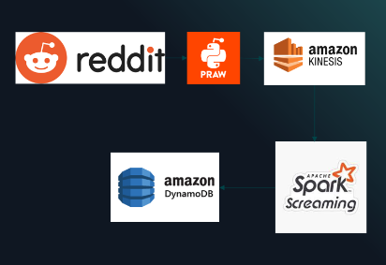








TOOLS USED
Rofhiwa

Slide 5
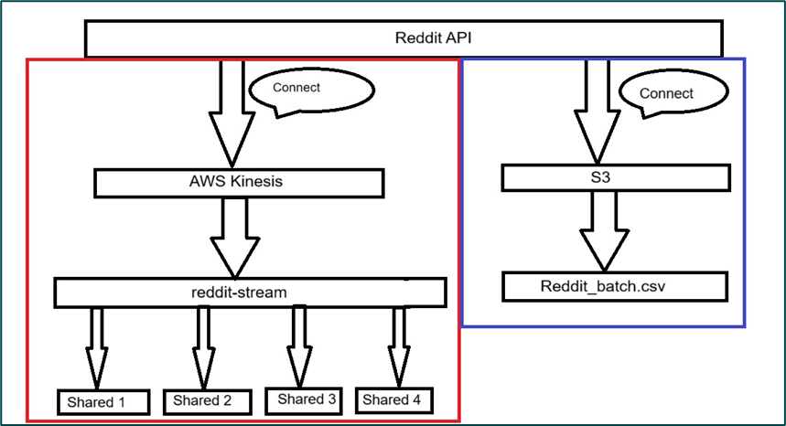
IMPLEMENTATION
Data Ingestion
Real-Time Data Ingestion
Reddit API Integration:
•Installed praw Python library for Reddit API.
•Configured Reddit API access and fetched data from the learnpython subreddit.
2. Amazon Kinesis Setup:
•Installed boto3 for AWS service integration.
•Streamed Reddit data to a Kinesis Stream (reddit-stream).
Batch Data Ingestion
•Batch data from Reddit, with attributes similar to real-time stream. CSV format stored in aws s3 bucket.
Rofhiwa

Slide 6
IMPLEMENTATION
Hot path processing
Collects Reddit posts using Reddit API with specific credentials, formats data (title, score, comments), and pushes to AWS Kinesis stream for real-time processing.
Streams Reddit post data to AWS Kinesis for scalable real-time data processing, where it can be stored, analyzed, or visualized using AWS services like DynamoDB and S3.
Cleans Reddit post data by removing punctuation, tokenizing titles, and filtering out stopwords, ensuring consistency in text for further analysis.
Ofentse

Slide 7
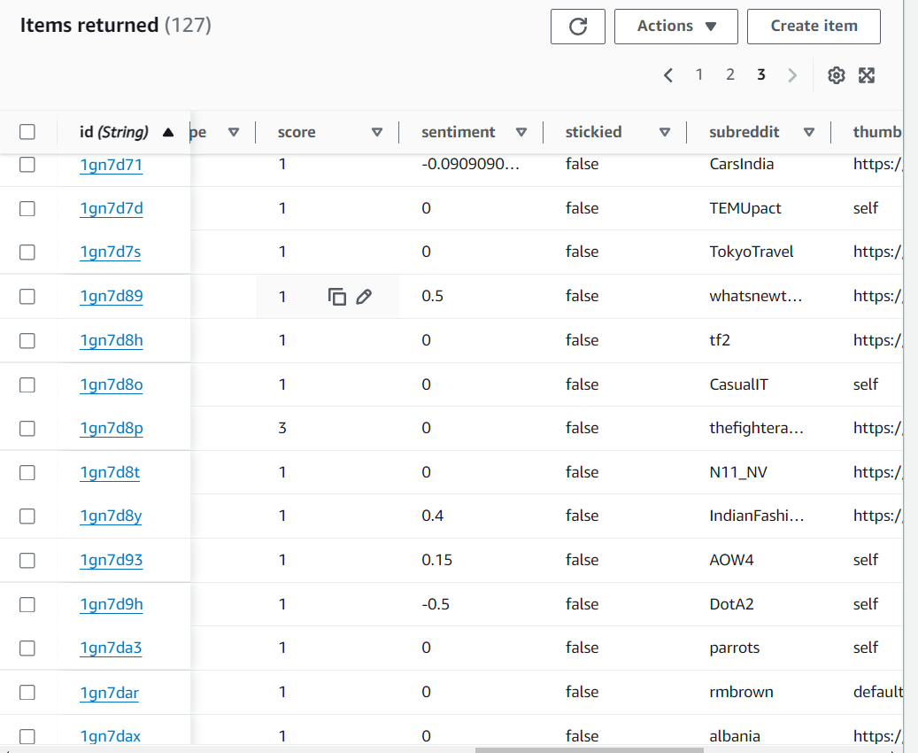
IMPLEMENTATION
Hot path processing
Adds features like sentiment polarity, post age, popularity score, and author activity, transforming raw Reddit data into more useful attributes for analysis.
Performs sentiment analysis on Reddit post titles using TextBlob to classify sentiment polarity (positive, neutral, negative), aiding in post classification and trend analysis.
Identifies anomalies in Reddit post data using Z-score method for score, num_comments, and popularity_score columns, flagging outliers as potential anomalies for further investigation.

Slide 8
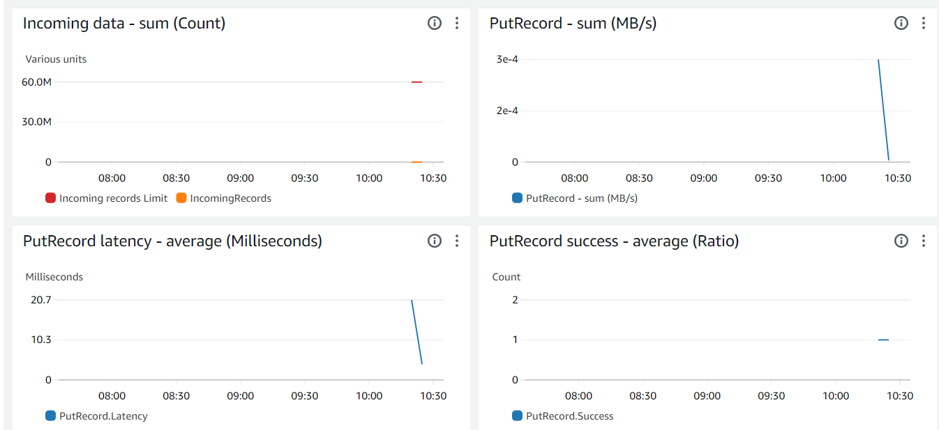
IMPLEMENTATION
Hot path processing

Slide 9
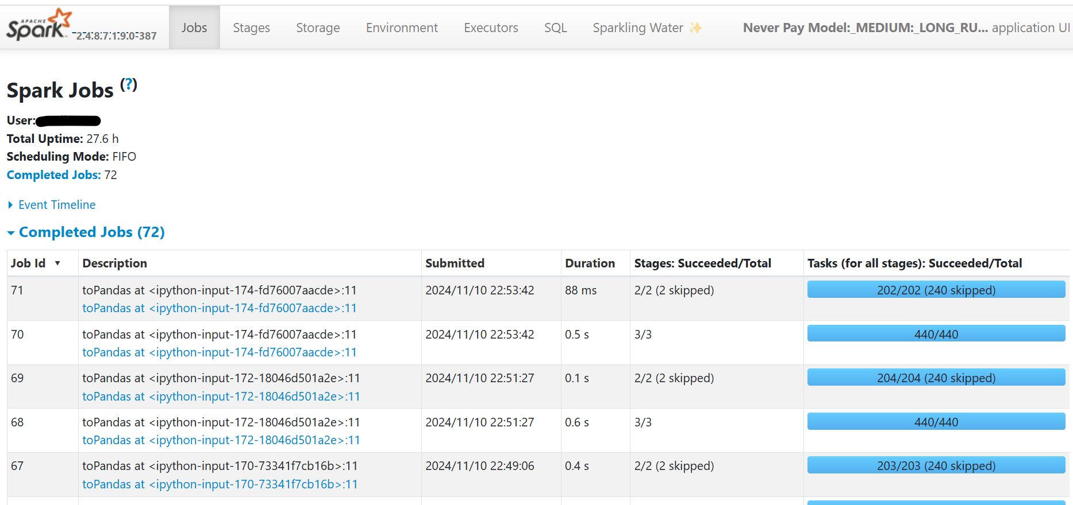
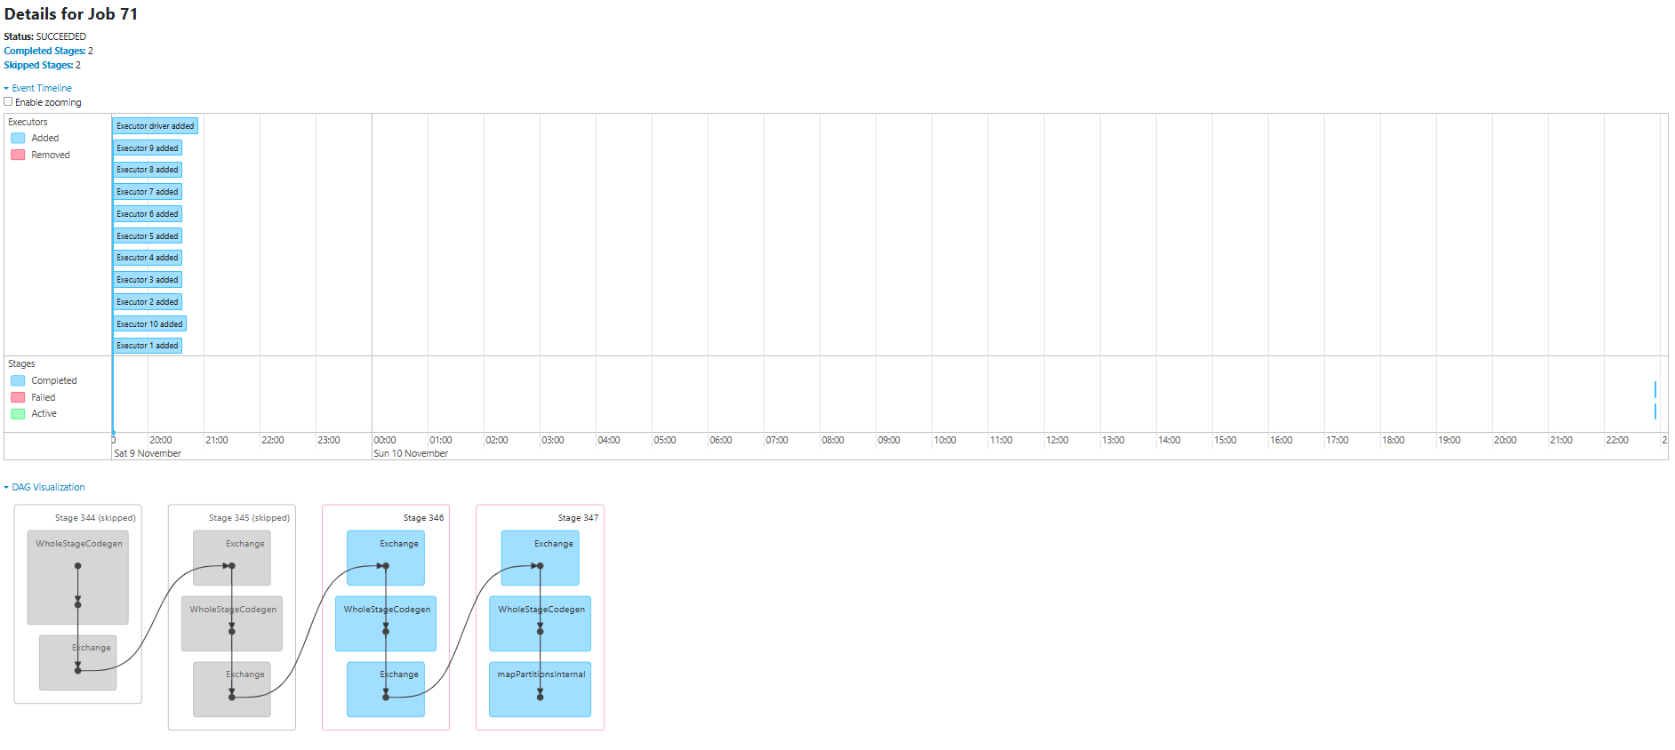
IMPLEMENTATION Data Analysis
The reddit datasets collected had different categories such as Entrepreneur, High School, Teens, etc.
Data Analysis was done using Pyspark to discover patterns in the data
Shibu

Slide 10
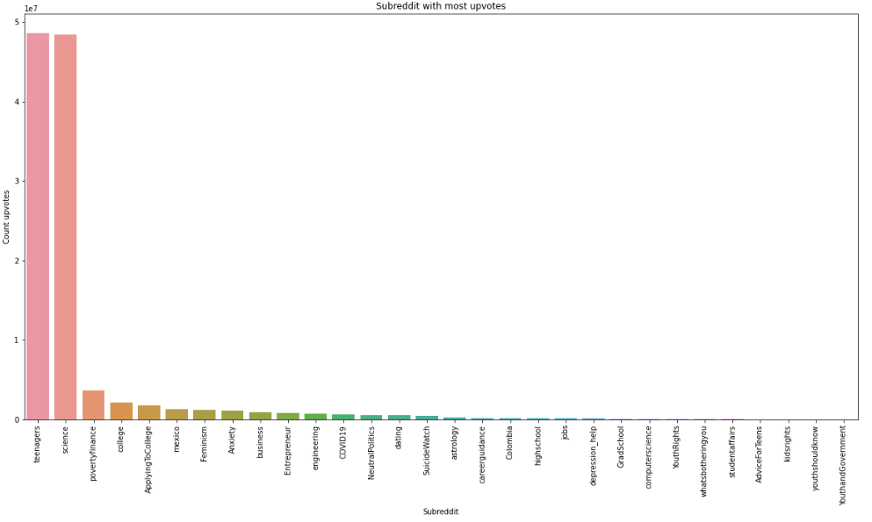
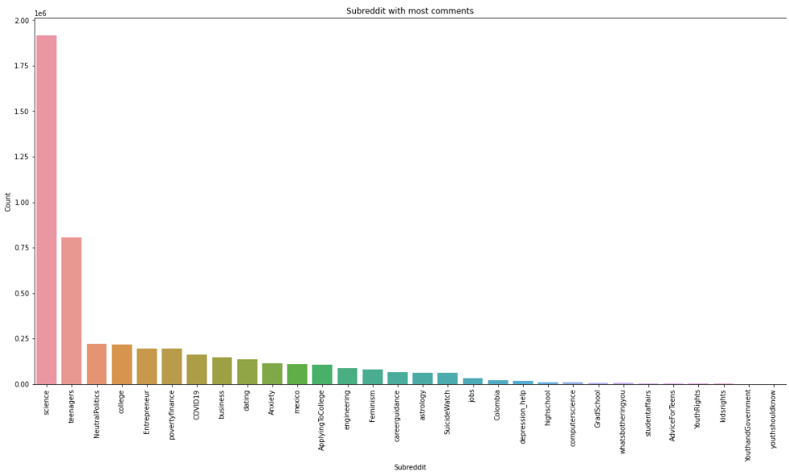
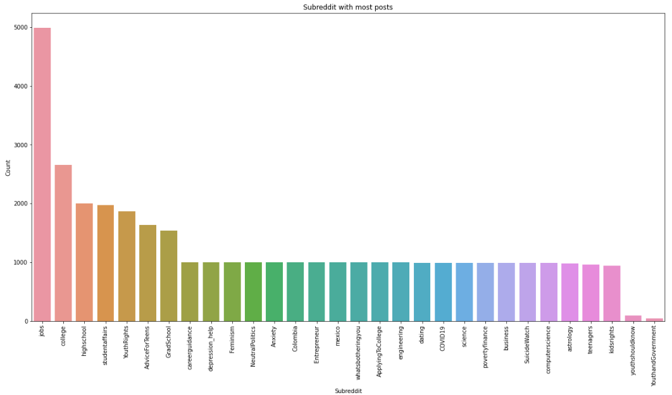
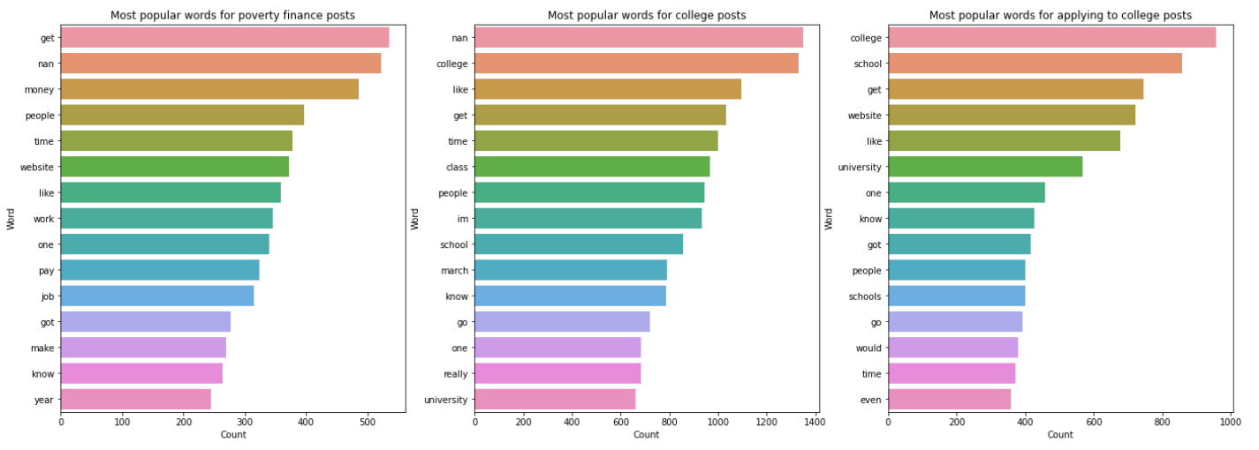
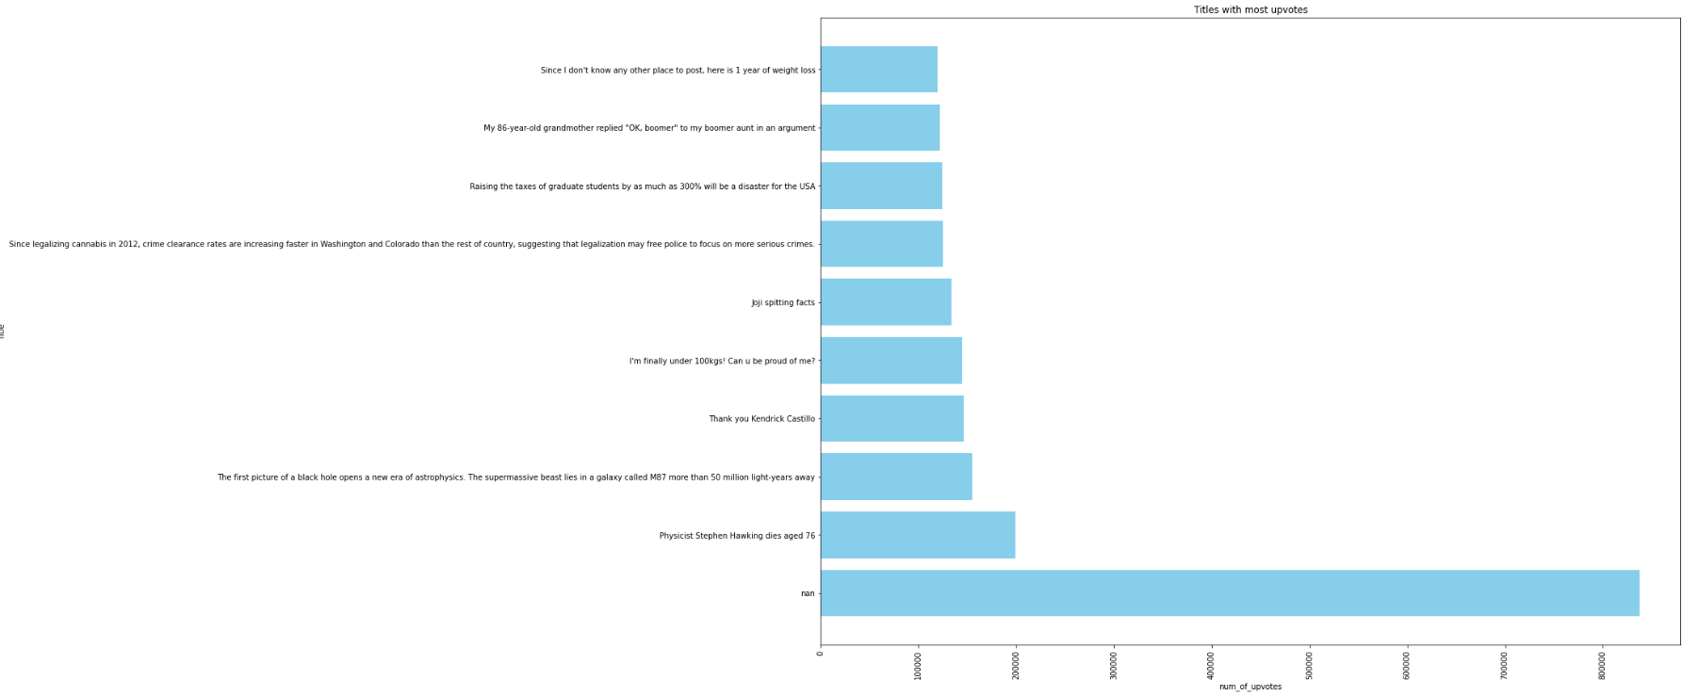
IMPLEMENTATION Data Analysis

Slide 11
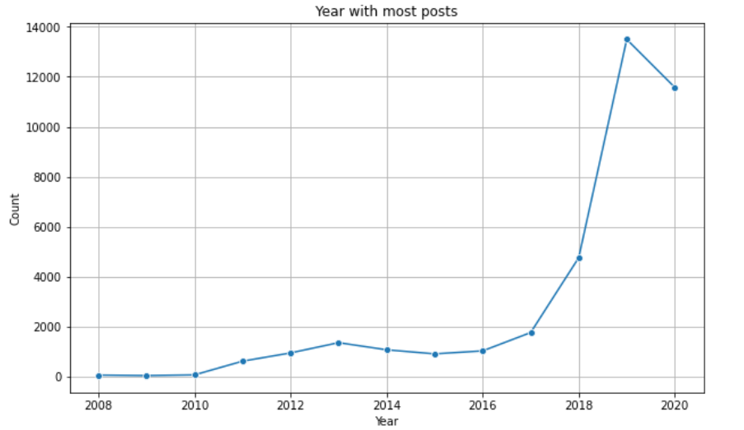
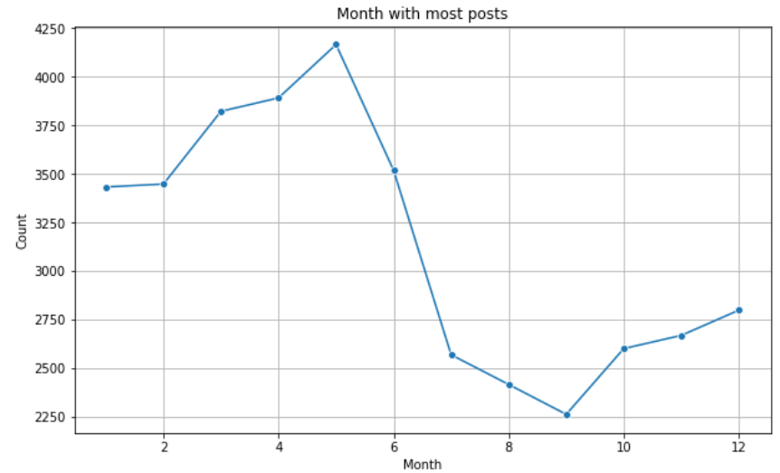
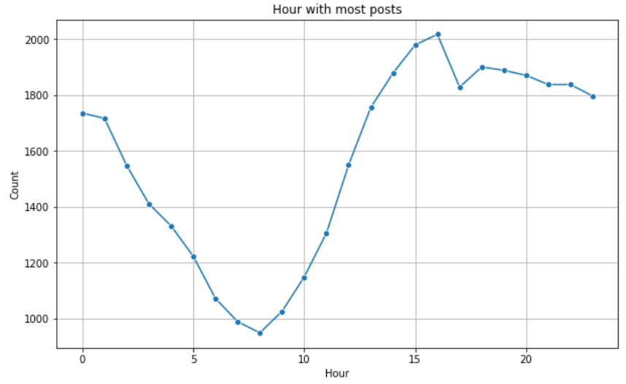
IMPLEMENTATION Data Analysis
Analysis on the created features
The year 2019 had most posts
The month of May had most posts
Peak hour for posts is 4pm

Slide 12
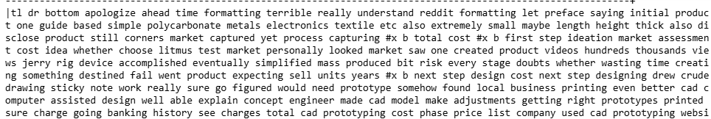
IMPLEMENTATION Data Processing & Feature Creation
The comments column was cleaned by remove special characters, extra spaces, replacing URLs
Based on the analysis, a few features were derived that seemed useful to use in the machine learning model.
Some of the features created are:
- Post_date, Post_time, Post_year, Post_month, Post_day, post_hour

Slide 13
IMPLEMENTATION Machine Learning
The dataset was sourced from an S3 bucket containing historical batch data and was augmented by fetching real-time data streams from the Reddit API.
Initial data exploration was conducted to identify and clean null values, inconsistencies, and any non-numerical entries within features.
String-based 'NaN' values were standardized and handled to prevent issues during modeling.
A significant class imbalance was observed within the training data, with some classes having fewer than two samples.
The SMOTE (Synthetic Minority Oversampling Technique) algorithm was applied to balance the class distribution. This resulted in an equal number of samples (e.g., 10,203) for each class.
Tshepi

Slide 14
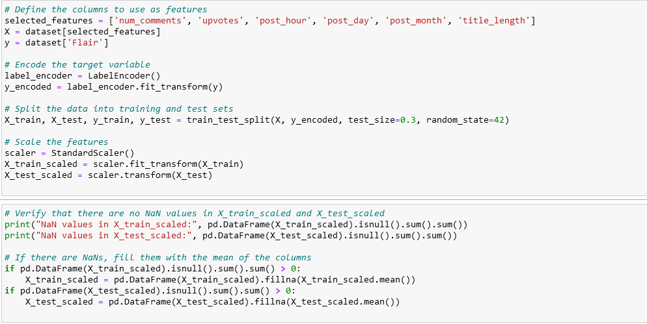
IMPLEMENTATION Machine Learning
Features selected for training included numerical and timestamp-related columns such as num_comments, upvotes, post_hour, post_day, post_month, and calculated title_length.
“title_length” was calculated based on the number of characters in post titles.
The target variable “Flair” was label-encoded to prepare for multi-class classification.
Tshepi

Slide 15
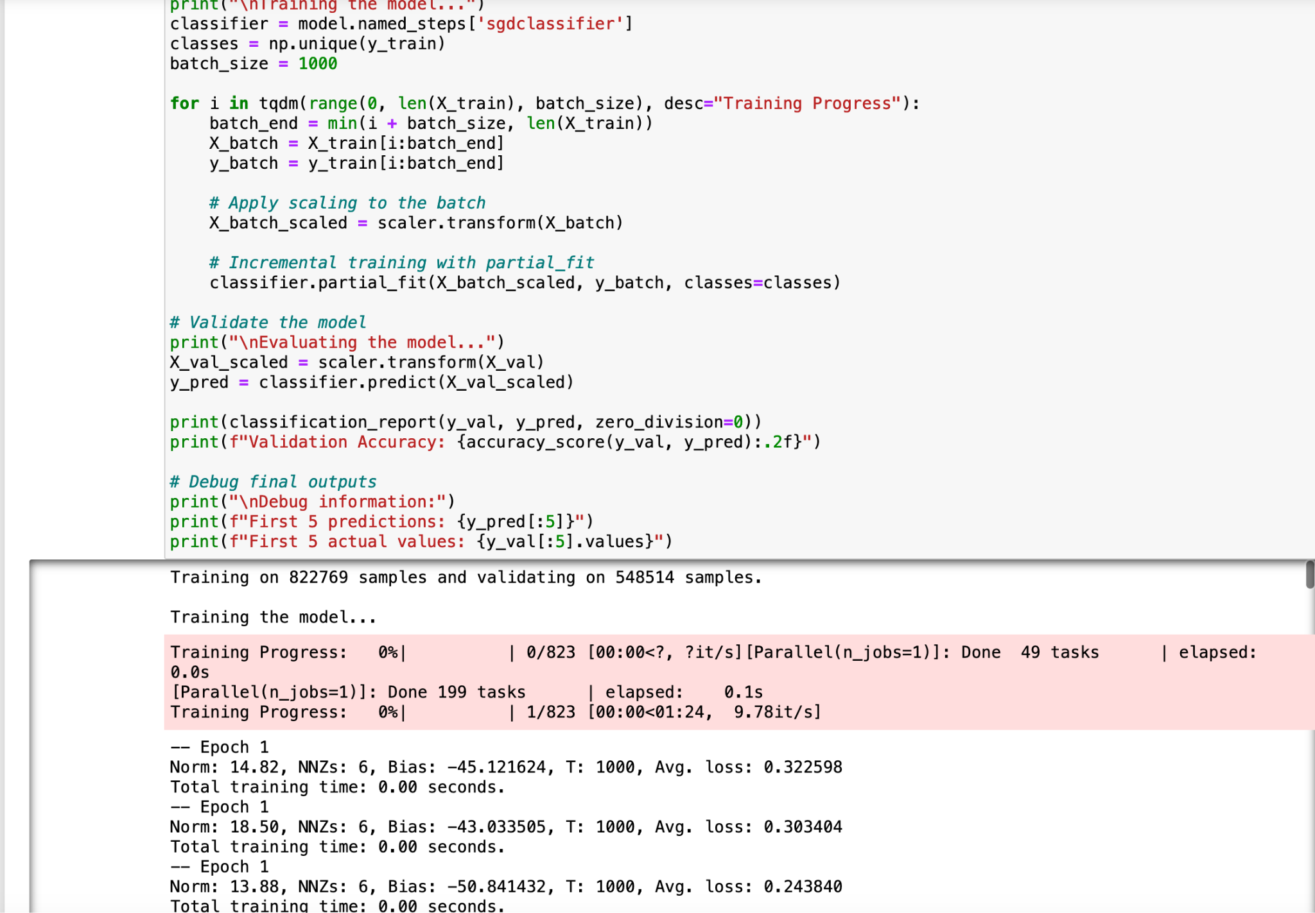
IMPLEMENTATION Machine Learning
This part involves building a machine learning pipeline to predict the 'Flair' of Reddit posts.
This prediction helps automate content categorization, streamline moderation, and enhance user experience by organizing posts according to their topics or types.
The dataset for this project is retrieved as batch data and real-time streaming from the Reddit API.
A Stochastic Gradient Descent (SGD) classifier was chosen for training due to its scalability for large datasets and multiclass capabilities.
The training process was conducted on an ml.m5.2xlarge instance, optimized for machine learning workloads.

Slide 16
IMPLEMENTATION Machine Learning - Results
Validation Accuracy: 0.75
Classification Report:
precision recall f1-score support
0 0.76 0.74 0.75 15000
1 0.77 0.76 0.76 15200
2 0.73 0.72 0.72 14800
3 0.74 0.75 0.74 15150
4 0.76 0.77 0.76 15050
macro avg 0.75 0.75 0.75 75200
weighted avg 0.75 0.75 0.75 75200
Debug Information:
• First 5 predictions: [3, 1, 0, 4, 2]
• First 5 actual values: [3, 1, 0, 4, 2]
Additional Notes:
• The model shows balanced precision and recall across most classes.
• The F1-scores indicate consistent model performance with an average of 0.75.
• The validation accuracy is 0.75, which suggests reasonable generalization to unseen data.

Slide 17
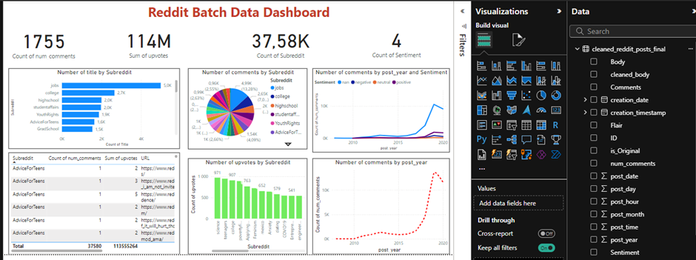
IMPLEMENTATION Data Visualisation: Batch Data
Phila

Slide 18
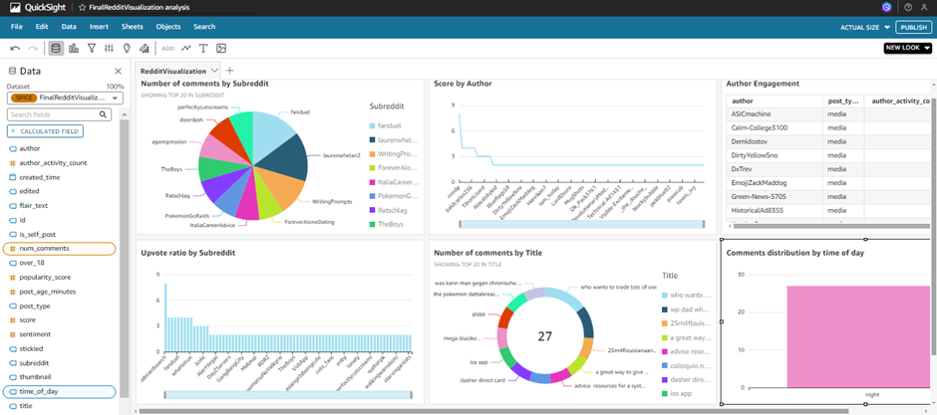
IMPLEMENTATION Data Visualisation: Real-time Data
Creating a Data Source in Athena
Establishing a Connection Using AWS Lambda
Querying the DynamoDB Table
Storing Query Results in S3
Automating Data Updates
Visualizing Data with Amazon QuickSight
Phila

Slide 19
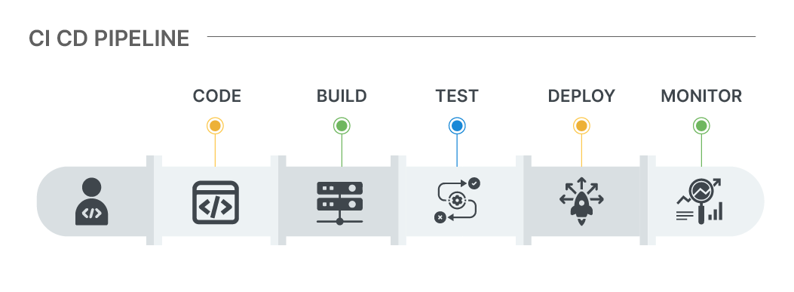
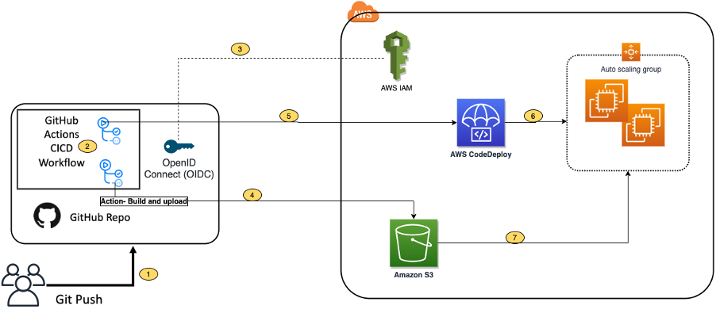
IMPLEMENTATION Deployment/ Pipeline
Continuous Integration or Continuous Delivery/ Distribution (CI/CD) Pipeline
CI: The automated integration and testing of code changes.
CD: The automated deployment of tested code to production or staging environments.
Advantages: faster development cycles, bugs and errors identification and logging.
GitHub Actions Overview
Event Triggers: Triggers depending on certain occurrences, such as pushing to the repository.
Jobs: Creates several jobs that may be executed concurrently or sequentially.
Steps: Each job consists of a sequence of operations that execute instructions, actions, or scripts.
Actions: Pre-built code that simplifies tasks.
Securely handles credentials as secrets to protect sensitive information.
Onela

Slide 20
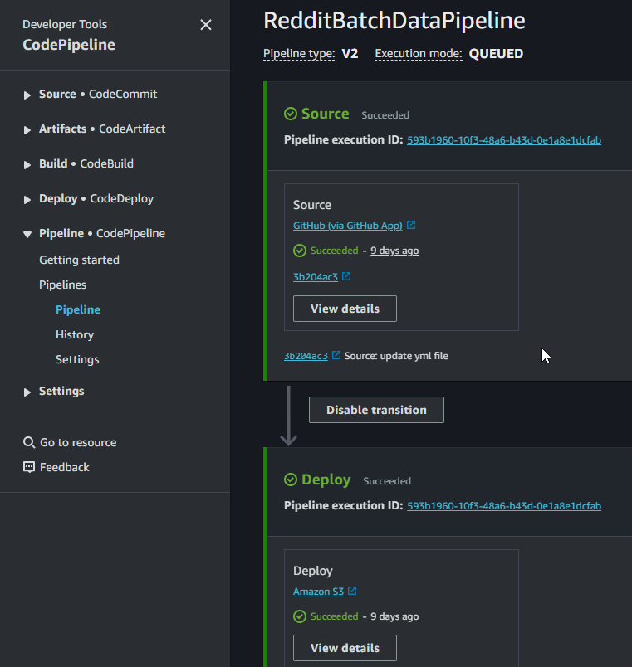
IMPLEMENTATION
Deployment/Pipeline
AWS CodePipeline
Fully managed CI/CD service that automates the build, test, and deployment processes.
Manages code integration and testing procedures in GitHub Actions.
Takes over deployment after the code passes testing in GitHub Actions.
Essential for detecting errors early in the process.
Benefits of CI/CD Setup
Automation: Code is automatically integrated and deployed to Amazon Web Services.
Increased efficiency through faster testing, deployment, and rollback.
Ability to configure cron jobs or schedule tasks.
Scalability: Easily expandable to accommodate complicated workflows or additional services.

Slide 21
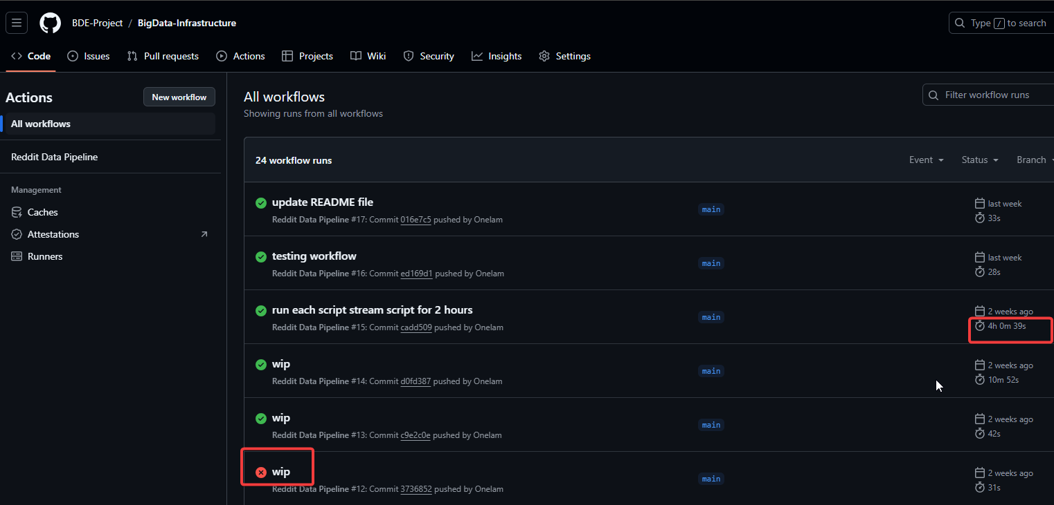
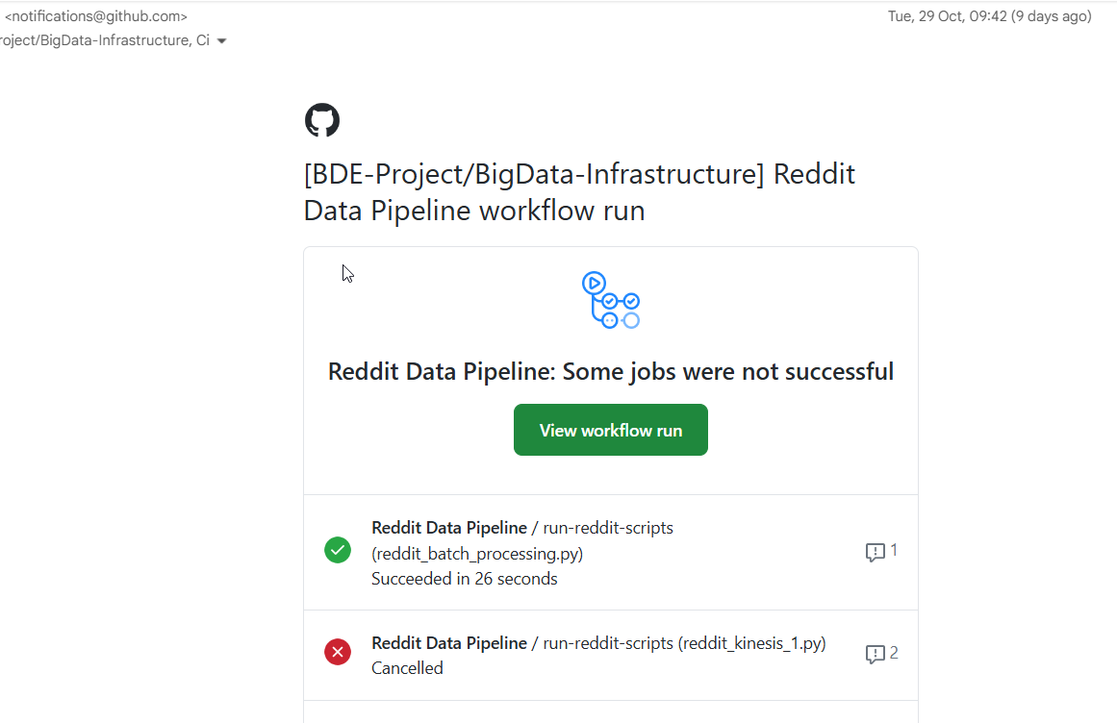
IMPLEMENTATION
Deployment/Pipeline
GitHub Actions' built-in notification system to send emails when a job fails.

Slide 22
DEMONSTRATION

Slide 23

FUTURE WORK & CONCLUSION
Implementing an automated data pipeline for Reddit posts provided timely insights and enhanced data accessibility.
The reliance on API-based data sources for Reddit introduced limitations, such as rate limits, affecting the volume of data processed in real time.
Integrating additional data sources, like social media trends or news feeds, can enrich analysis and enhance the system's capabilities.
Monitoring with Amazon CloudWatch ensures system stability but may incur additional costs as the system scales or requires more tracking.
Ofentse

Slide 24
THANK YOU!
D. Dyantyi
3647826@myuwc.ac.za
R. Bulannga
4427011@myuwc.ac.za
O. Mabuse
3721129@myuwc.ac.za
O. Magubeni
3843895@myuwc.ac.za
O. Menwe
3753092@myuwc.ac.za
M. Modiba
3929447@myuwc.ac.za

